Slide 1
Team PYJAH Sprint 3
Jeff Au – Project Manager
Paul Ojo – Scrum Master
Howie Huntington - Programmer
Yang Li -Programmer
Ammanuel Getenet -Tester

Slide 2

What is the product?
It’s an application that uses Java to mirror an e-mail messaging system.
Features:
The user interface is built using JavaFx and the Jfoenix Library that allowed us to create a modern and user friendly messaging client.
It will implement RSA encryption for the security of the users credential and the e-mail/messages that are being sent and received.
It will run on any system that has the JVM installed.

Slide 3
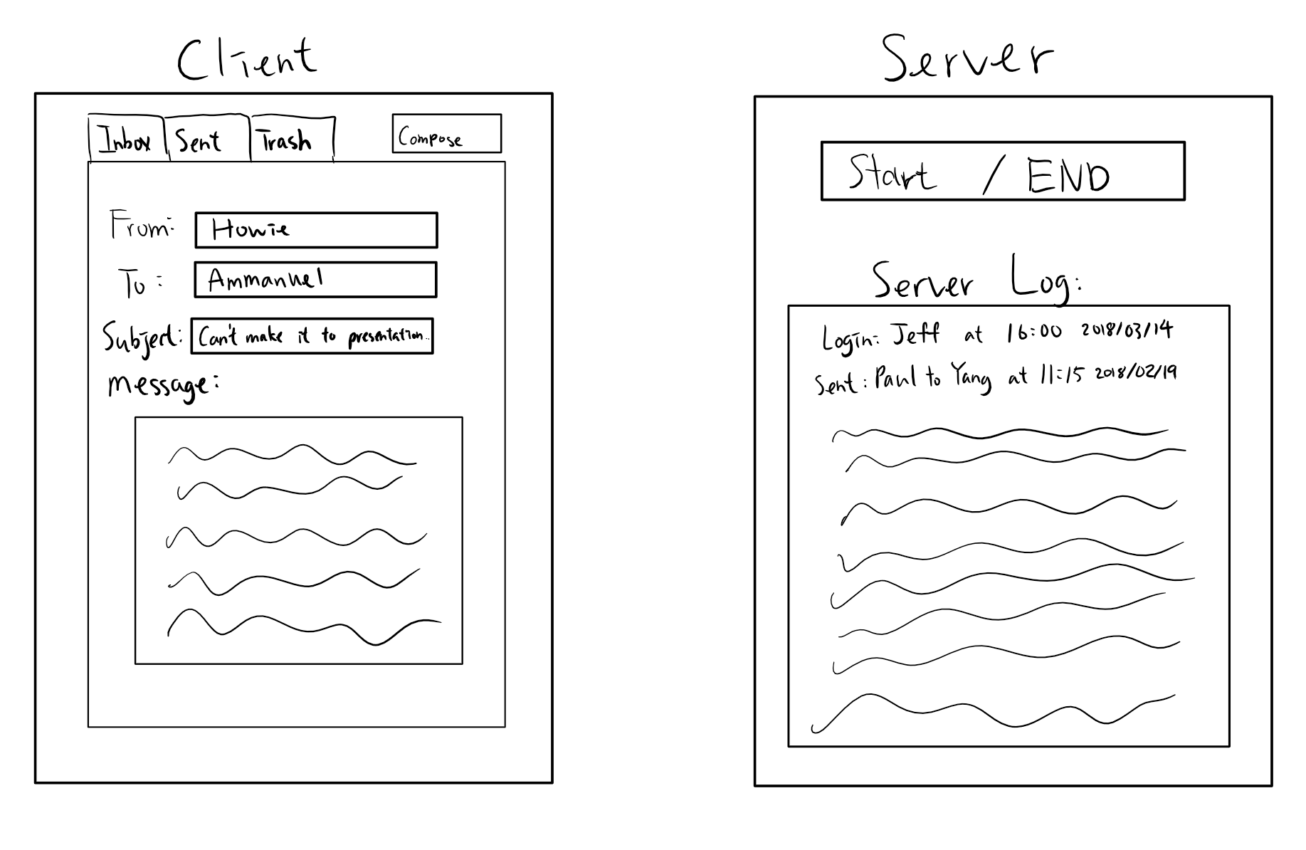
GUI Design
From our last presentation…

Slide 4
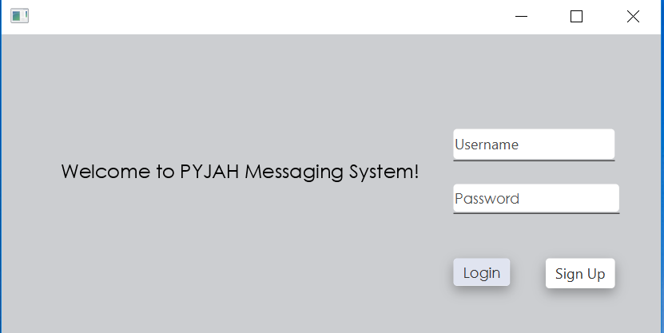
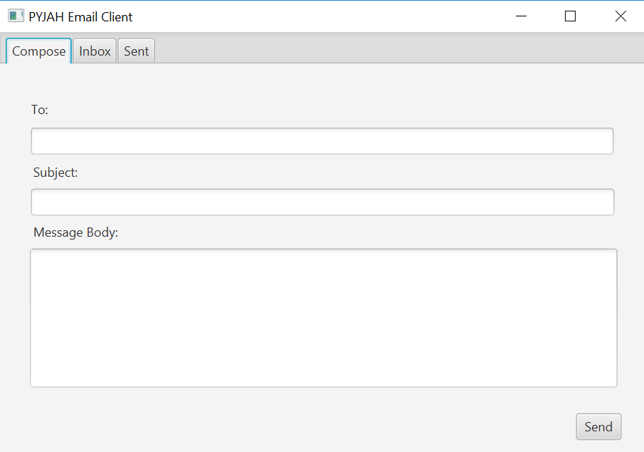
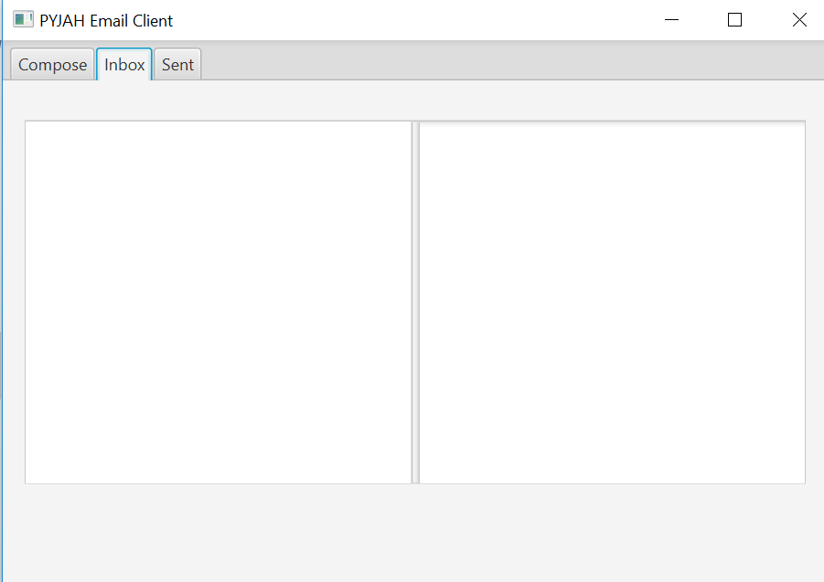
GUI Design

Slide 5
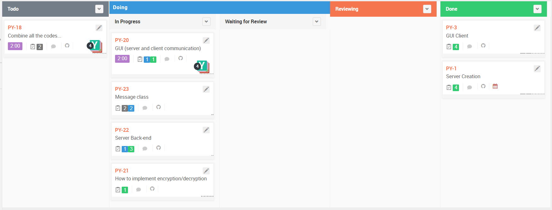
Story Board: Iteration #3

Slide 6
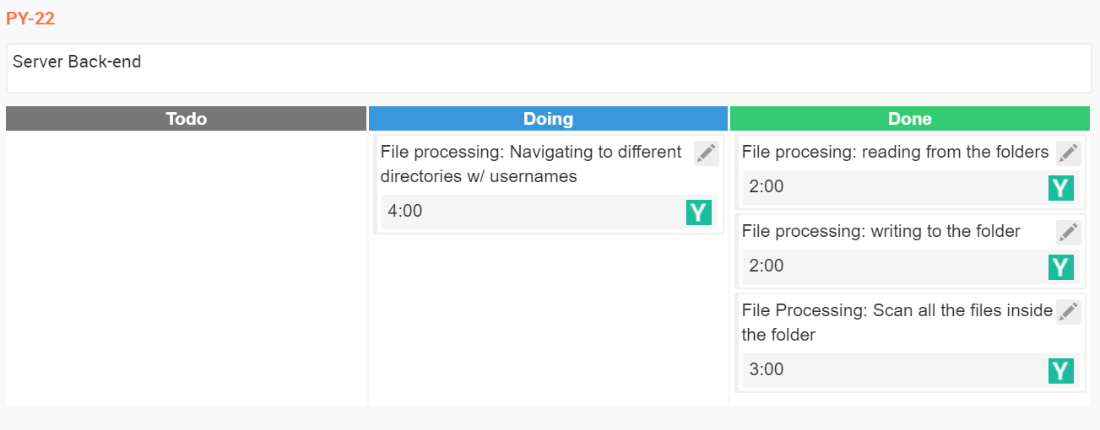
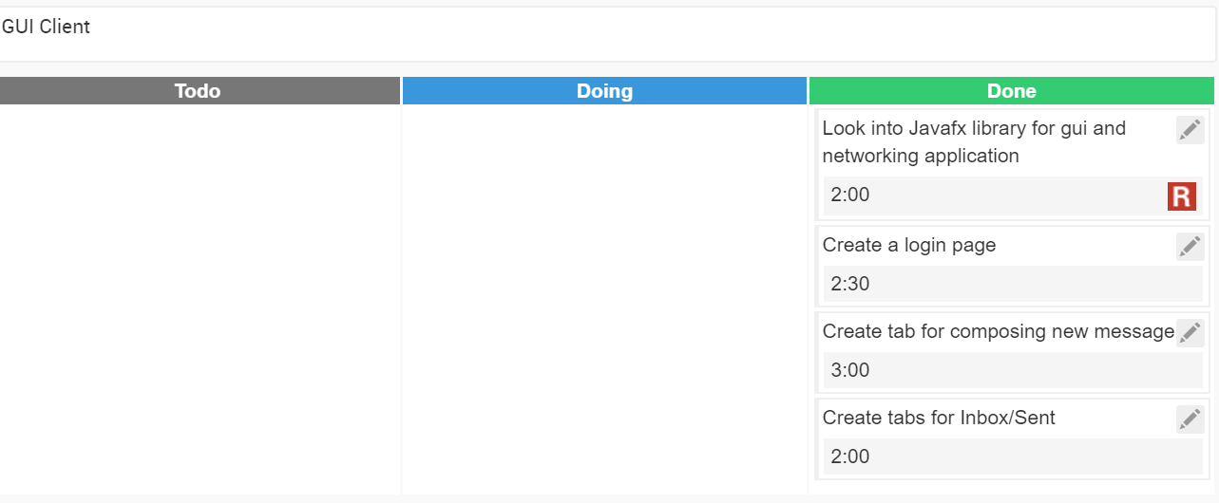
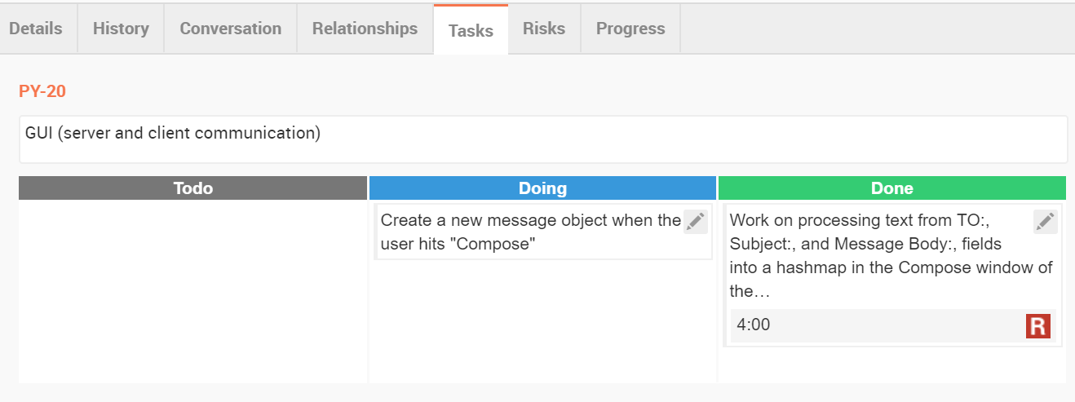
Completed Tasks

Slide 7
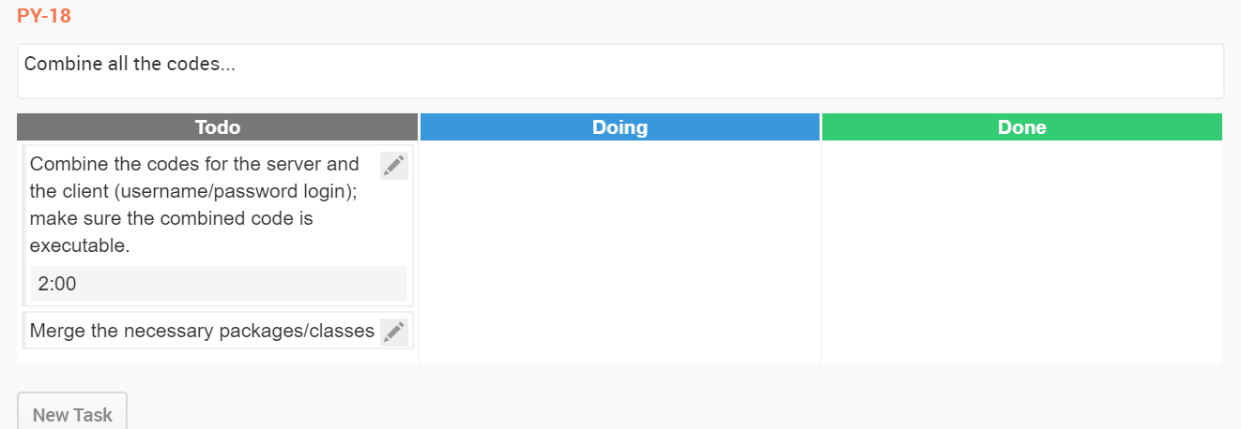
Backlogged Tasks

Slide 8
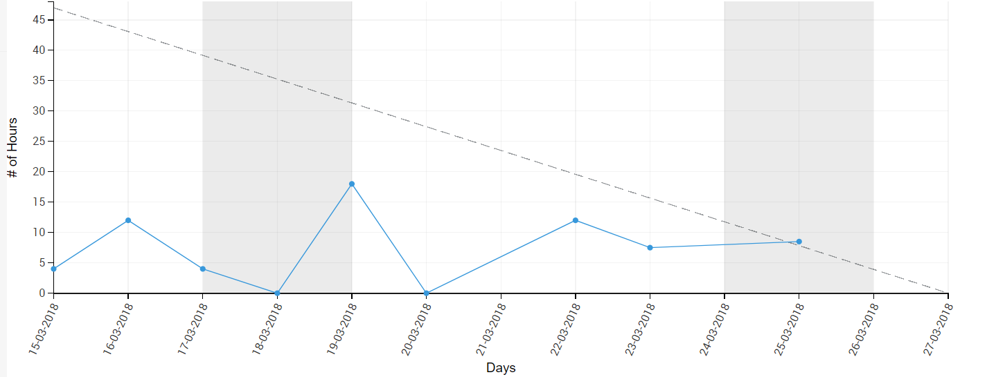
Burndown Chart

Slide 9
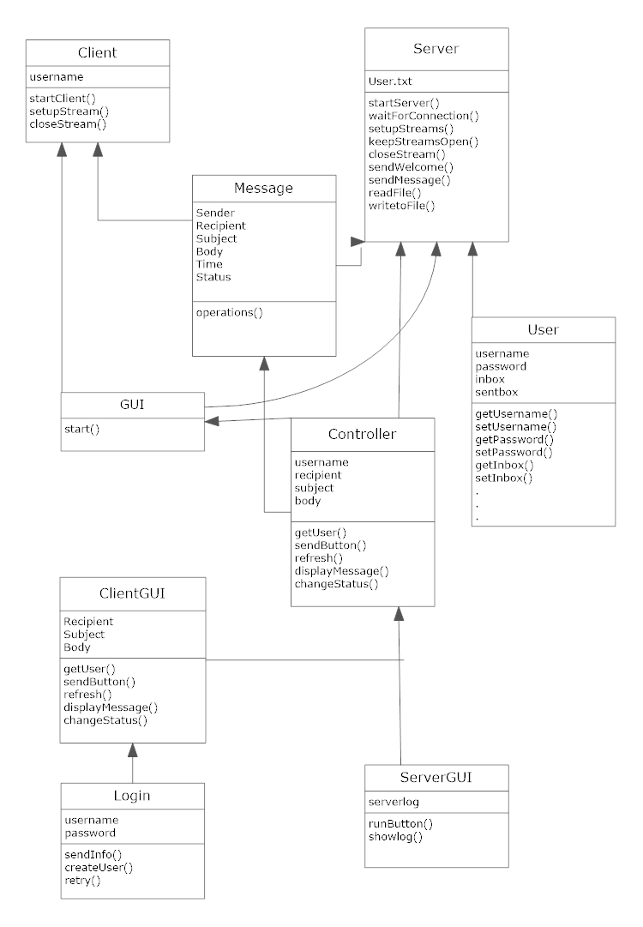
Object-class Diagram overview

Slide 10
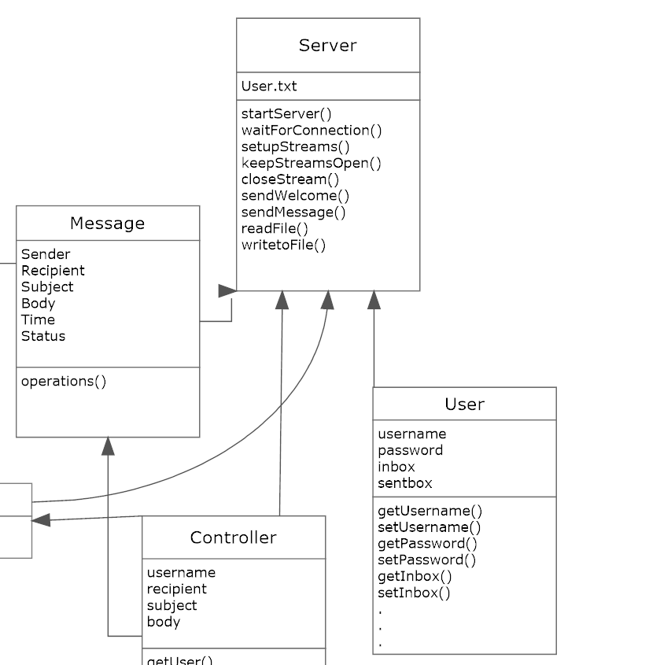
Object-class Diagram: Message & Server

Slide 11
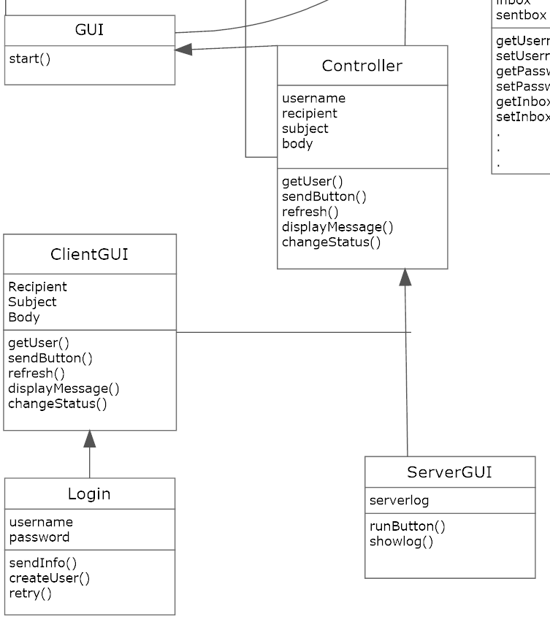
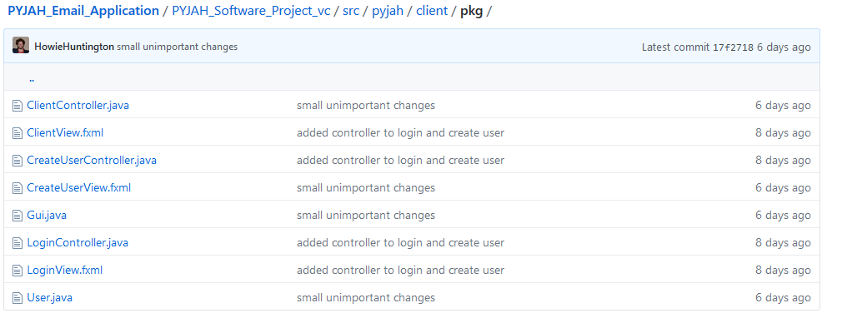
Object-class Diagram: GUI
One controller for each fxml

Slide 12
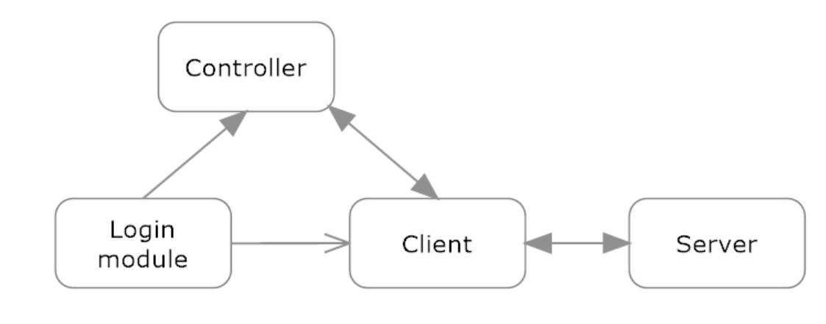
Scenario Test Plan & Context Diagram
Scenarios to test:
1)Test if user enters wrong password?
2) if recipient is does not exist, what then?
3)What happens if the subject line is empty?

